Slide 1
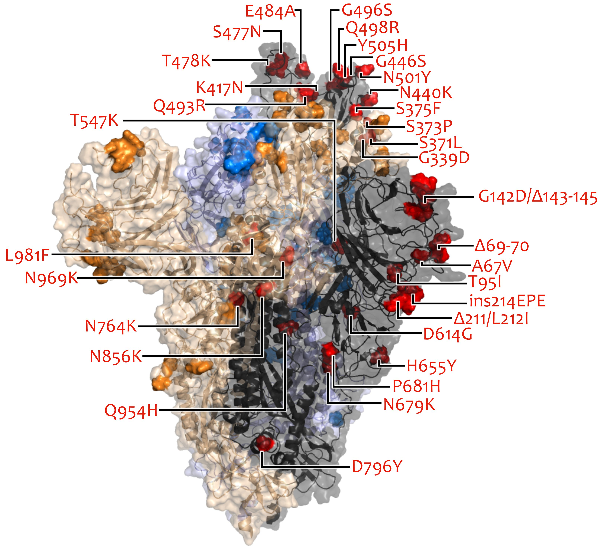
VOC/VOI in Deutschland aktuelle Situation
FG36, FG32, MF1, MF2, MF4, AG Evo, FG17 Berlin, 01.02.2023

Slide 2
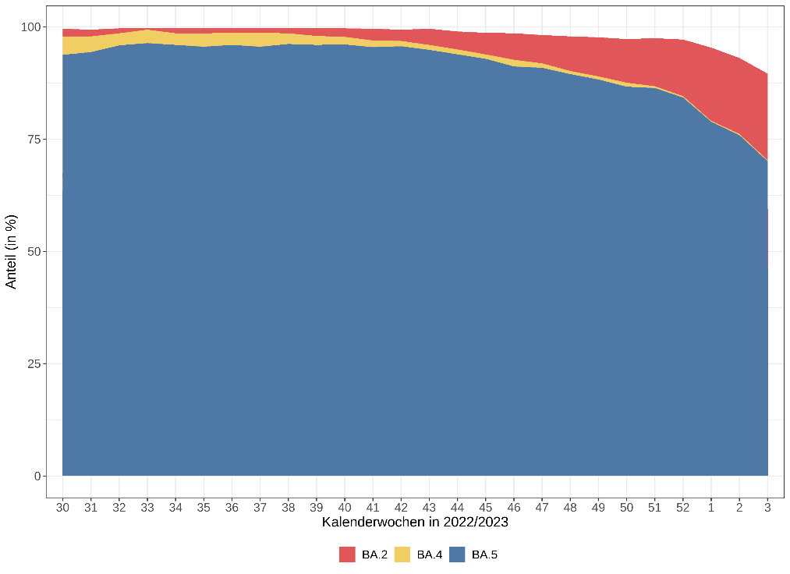
VOC Anteile
KW /Jahr | Omikron
 | BA.2 | BA.4 | BA.5 | XBB.1.5 | XAY
46/2022 | 5,3 % | 1,5 % | 91,3 % | 0 % | 0 %
47/2022 | 6,3 % | 1 % | 91,2 % | 0 % | 0,1 %
48/2022 | 7,9 % | 0,6 % | 89,5 % | 0 % | 0 %
49/2022 | 9 % | 0,6 % | 88,3 % | 0,1 % | 0 %
50/2022 | 9,7 % | 0,8 % | 87,0 % | 0,3 % | 0,1 %
51/2022 | 10,1 % | 0,4 % | 87,2 % | 0,3 % | 0,1 %
52/2022 | 11,9 % | 0,3 % | 85,1 % | 0,9 % | 0,1 %
1/2023 | 15,8 % | 0,2 % | 79,4 % | 2,4 % | 0,1 %
2/2023 | 17,2 % | 0,3 % | 75,8 % | 3,9 % | 0,1 %
3/2023 | 19,5 % | 0,1 % | 70,1 % | 5,6 % | 0,2 %
KW /Jahr | Stichprobe Anzahl | Anteil an übermittelten Fällen
51/2022 | 5000 | 2,2%
52/2022 | 3110 | 2,1%
1/2023 | 3335 | 2,6%
2/2023 | 2785 | 3,1%
3/2023 | 1327 | 2,1%
Notes:
ECDC zu XAY:
The recombinant lineage XAY (BA.2-Delta recombinant) was added as variants under monitoring (VUM). XAY.2 is by far the most prevalent XAY lineage in the world, but for now it has only been detected at very low levels. XAY.2has mainly been detected in Denmark, where it is present at around 2% of sequences in recent weeks, but the growth of the variant is not quick, in proportion.
cov-lineages/pango-designation zu XAY:
These look like some weird combination of three different lineages: AY.45, a divergent BA.4/5, and BA.2 (seen near the 3' end where BA.4/5 mutations are absent from the Omicron-derived sections). Both have lots of apparent breakpoints but the 3' end of constellation 2 is particularly messy and seems to switch back and forth almost every mutation - the N protein alone goes Omicron/Delta/Omicron/Delta. https://github.com/cov-lineages/pango-designation/issues/844
Concerning mutation: F486P

Slide 3
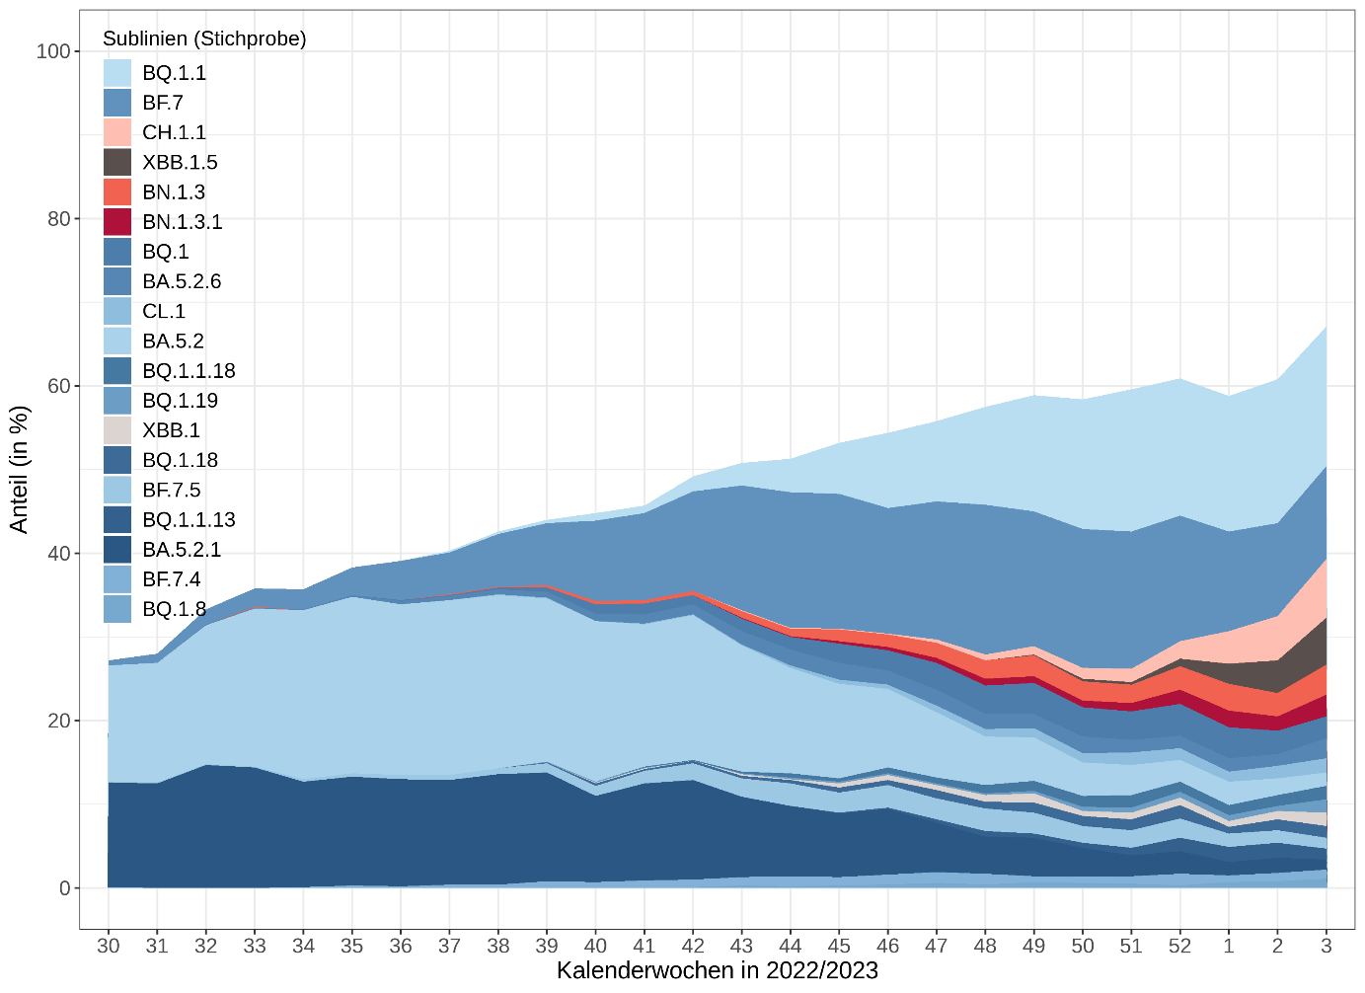
SARS-CoV-2 Varianten >
KW1/2023 (Stichprobe)
Omikron 100%
BQ.1.1* 26,3%
BF.7* 15,1% (S:K444T, S:N460K)
BA.2.75* 18,9%
XBB.1* 8,1%
XBB.1.5 5,6% (S:S486P)
BQ.1 2,6%
BA.2.75 Sublinien (S:K356T, S:R346T)
CH.1.1 7,0% (S:K444T, S:F486S,S:L452R)
BN.1.3 3,6% (S:F490S)
BN.1.3.1 2,6% (S:F490S)
* inkl. Sublinien
Hinweis: Anteil der Sequenzen der Stichprobe an übermittelten Fällen beträgt für KW 3/2023 nur 2,1% (Gesamt 2,2 %).
ECDC: XAY* → Variant Under Monitoring (26/01/2023)

Slide 4
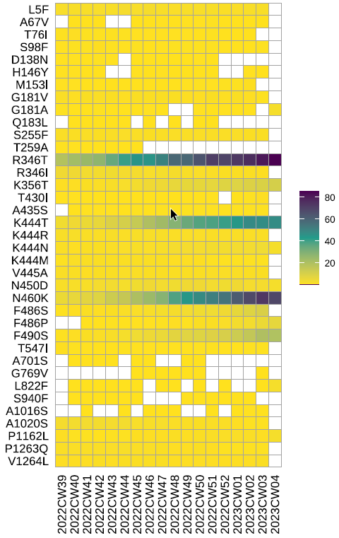
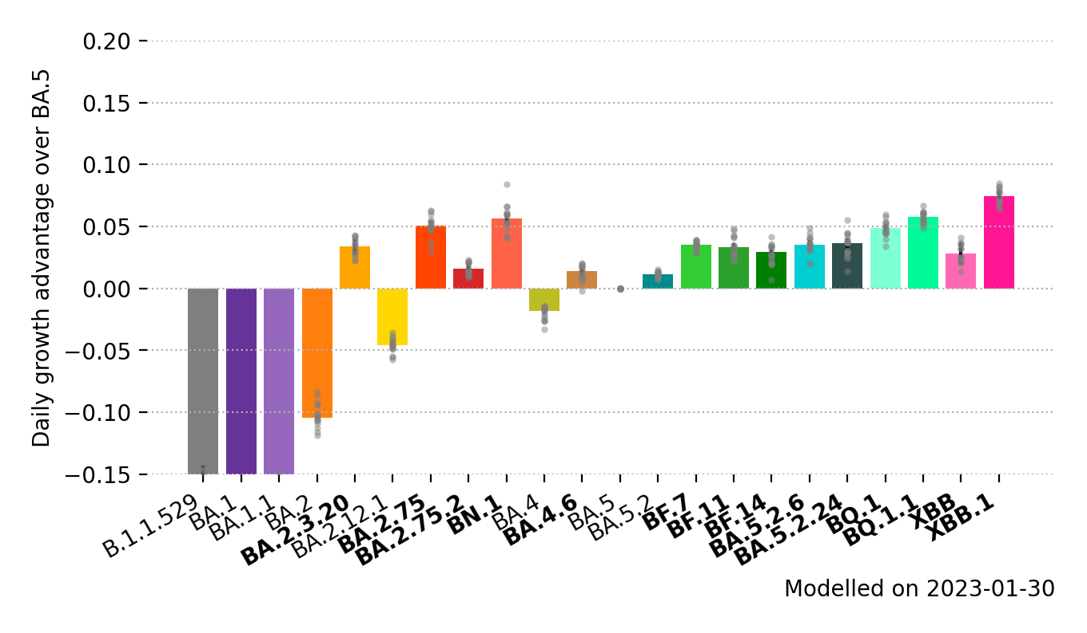
MOCs
S:R346T, S:K444T, S:N460K (BQ.1.1) → antibody escape /enhanced neutralization resistance
S:F486P (XBB.1.5, XAY)→ immune escape, enhanced ACE2 receptor binding
S:F490S (BN.1*, BN.1.3*)
BN.1
Wachstumsvorteil
XBB.1.5 , XAY
BN.1.3*
Notes:
covSPECTRUM: The XBB.1.5 variant above) currently exhibits a daily growth advantage of 12% (95%CI 11-13%) in the US compared to other circulating variants
If the difference in observed growth rate would be completely explained by an increase in inherent transmissibility, it would correspond to an increase of between 27% and 62% in the basic reproduction number (R0) compared to other XBB variants circulating in the US, using an assumed generation time range between two published estimates of 3.3 and 6.8 days [14,15].
Zusatz: According to a preliminary study, XBB and XBB.1.5 have very similar antigenic properties, while XBB.1.5 exhibits significantly stronger binding to the human ACE2 receptor, similar to that of BA.2.75 [13]. It is therefore plausible that the difference in growth rate between XBB and XBB.1.5 is mainly explained by a difference in transmissibility (Quelle: https://www.ecdc.europa.eu/sites/default/files/documents/TAB-Implications%20for%20the%20EU-EEA%20of%20the%20spread%20of%20the%20SARS-CoV-2%20Omicron%20XBB.1.5%20sub-lineage.pdf)

Slide 5
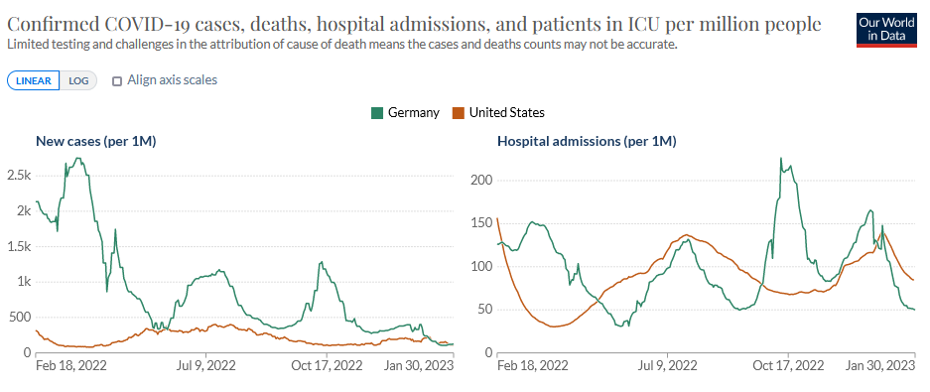
XBB.1.5
WHO (25.1.23):
revised the confidence level of the risk assessment for XBB.1.5 from “Low” (assessed on 11 January 2023) to “Moderate”
“XBB.1.5 does not appear to have additional public health risk relative to the other Omicron descendent lineages”
US: 61.3% of U.S. COVID cases in week 4/2023 (50 % in week 3/2023)
Europe: XBB.1.5, 2.4% (0.9–6.5% from seven countries) in week 3/2023
Non of 28 countries reporting case notification data up to week 3 reported increasing trends.
Notes:
Abb: https://ourworldindata.org/explorers/coronavirus-data-explorer?time=2022-02-18..latest&uniformYAxis=0&Metric=Cases%2C+hospital+admissions%2C+ICU+patients%2C+and+deaths&Interval=7-day+rolling+average&Relative+to+Population=true&Color+by+test+positivity=false&country=USA~DEU

