Slide 1
National Public Health Agencies (NPHAs) Workshop
14-15 March in Geneva, Switzerland
Krisenstab 29.3.2023 JH

Slide 2
National Public Health Agencies (NPHAs) Workshop
Leaders from selected Member States' NPHAs, regional entities, as well as global partners and networks involved in Health Emergency Preparedness and Response.
The workshop focused on the role of NPHAs in delivering essential preparedness and response capabilities for public health emergencies.
NPHA experiences, highlighting best practices in collaborative surveillance, community protection, safe and scalable clinical care, access to countermeasures, emergency coordination, financing for preparedness and response, and strengthening the public health workforce.

Slide 3
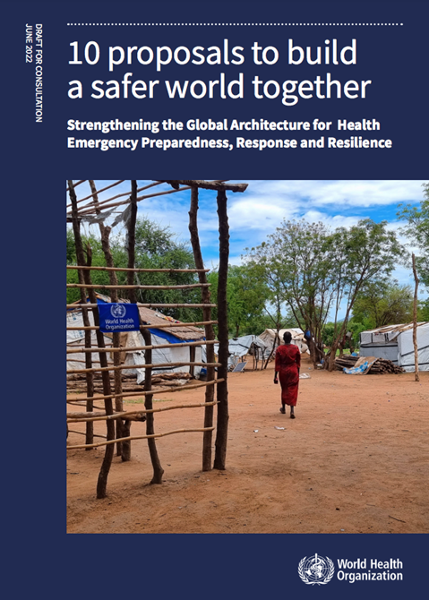
Diskussionsinhalt
RKI Erfahrung
Austausch
WHO Agenda:
HERP Prozeß:
WHA 2023
NPHAs Netzwerk

