Slide 1
COVIMPACT Hepatitis
Sandra Dudareva
Robert Koch Institute
07.06.2023

Slide 2
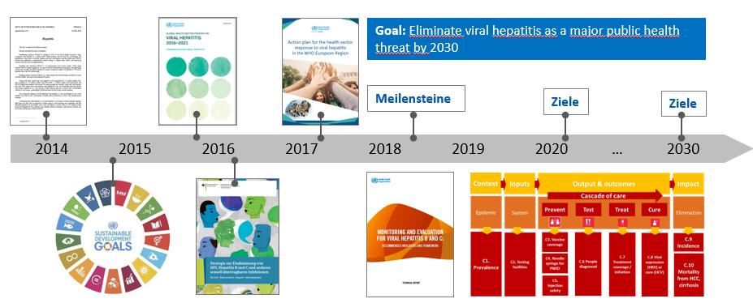
COVID-19 pandemic and viral hepatitis elimination
COVID-19 pandemic has likely affected the viral hepatitis (VH) elimination efforts:
re-allocation of healthcare resources and public health personnel
diminished accessibility to services
supply of tests and medicine
Alternative approaches for service delivery, testing and treatment, monitoring were necessary

Slide 3
COVIMPACT Hepatitis: Assessing the impact of COVID-19 pandemic on viral hepatitis B and C elimination efforts in Eastern Europe and Central Asia
COVIMPACT Hepatitis – GHPP Corona Global cooperation project:
Robert Koch Institute:
FG34 (WHO CC for viral hepatitis and HIV)
ZIG2
World Health Organization
Participating countries
Overall aim: facilitate VH elimination in the context of the current COVID-19 pandemic in Eastern Europe and Central Asia
Main objectives:
Assess impact of the COVID-19 pandemic on
VH elimination activities implementation
VH elimination indicators
delay in the implementation of VH elimination efforts
Technical support in reviewing national plans to scale-up VH elimination during and after COVID-19 pandemic
COVIMPACT Hepatitis

Slide 4
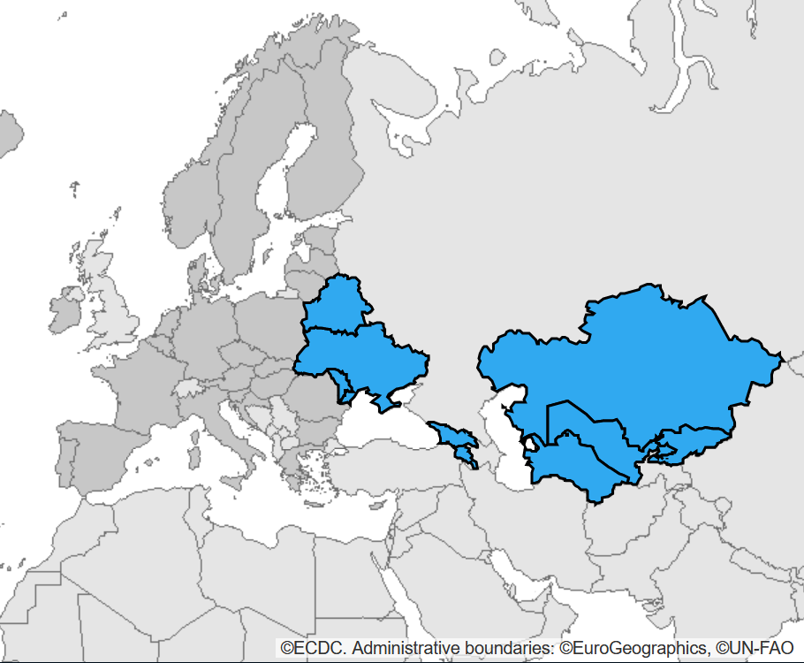
COVIMPACT Hepatitis: Work packages
WP1: Selection of participating countries
Four countries with national viral hepatitis elimination plans in the EECA region
WP2: Desk reviews
Overview of the current situation and review of the status of the national hepatitis elimination plan
WP3: Country missions
Discussing the results of the desk review and collecting additional information
Development of recommendations
WP4: In-depth studies
In two countries, detailed analysis of specific aspects of the elimination strategy
WP5: Joint evaluation workshop
In Berlin as hybrid event in October 2022
Source: https://www.knovos.com/
COVIMPACT Hepatitis

Slide 5
Ukraine: selected results
The number of individuals screened for viral hepatitis decreased by 32% from 2019 to 2020
Only 13% of those positive were confirmed in diagnostic tests associated with out-of-pocket payment
New standards of care were adopted in 2022 including reimbursement for testing
Decentralization of viral hepatitis treatment distribution led to an increase in the number of treated HCV patients by 147% in 2020
COVIMPACT Hepatitis

Slide 6
Kyrgyzstan: selected results
Implementation of a new electronic surveillance system during the pandemic
Testing and treatment limited to private providers with high likelihood of underreporting
HepB3 vaccination coverage dropped below the WHO target of 90% in 2020 and 2021
Development of a new national viral hepatitis elimination programme for 2022-2026 with dedicated financing for the first year
COVIMPACT Hepatitis

Slide 7
COVIMPACT Hepatitis: Overall conclussions
The COVID-19 pandemic posed additional challenges for reaching elimination targets to Member States in Eastern Europe and Central Asia
Access to healthcare services for testing and treatment was interrupted during the pandemic, but new opportunities for better monitoring, access to treatment, and elimination in general arose
Quick adaptations and increased flexibility of the healthcare system could absorb some of the impact of the COVID-19 pandemic
To get back on track, countries should utilize the currently increased attention for infectious diseases and direct it towards hepatitis elimination
COVIMPACT Hepatitis

Slide 8
Scale-up HIVHEP: Scaling up monitoring, control and elimination of HIV/AIDS and viral hepatitis in WHO European Region
Jan 2023-Dec 2025
Follow up project of COVIMPACT Hepatitis
Work packages:
2023-2025: Desk review of HIV and viral hepatitis program data
2023-2024: Technical support of HIV and viral hepatitis elimination in Kyrgyzstan
2024-2025: Burden of disease estimations of viral hepatitis B and C
2023-2024: Preparing for behavioural science studies

Slide 9
Main contributors and partners
RKI: Department of Infectious Disease Epidemiology
Michael Brandl
Viviane Bremer
Sandra Dudareva
Olena Kysil
Alba Méndez Brito
Ida Sperle-Heupel
Anastasiya Stepanovich
RKI: Centre for International Health Protection
Charbel El Bcheraoui
Brogan Geurts
Alyona Mazhnaia
Ukraine: Public Health Center
Iryna Ivanchuk
Olena Nesterova
Kyrgyzstan: Scientific Production Association Preventive Medicine
Zuridin Nurmatov
Gulsunai Sattarova
Uzbekistan: Research Institute of Virology
Erkin Musabaev
Shakhlo Sadirova
Armenia: National Centre for Infectious Diseases
Narina Sargsyants
WHO: Headquarters
Antons Mozalevskis
WHO: Regional Office for Europe
Marcelo Naveira (WHO Consultant)
Nicole Seguy
WHO: Country Offices
Jamshid Gadoev (Uzbekistan)
Gayane Ghukasyan (Armenia)
Kaliya Kasymbekova (Kyrgyzstan)
Igor Semenenko (Ukraine)
Riga Stradins University
Laura Isajeva
…and many more!

Slide 10
